Slide 1
MDT – Malt deployment toolkit
Phil Schwan
Solution Architect
Netrix LLC
Fred Bainbridge
Senior Consultant
NowMicro

Slide 2
Phil Schwan
Fred Bainbridge
@philschwan
@FredBainbridge
MCSE: Enterprise Devices & Apps, Mobility
Fantasy Baseball Champion
Almost 20 years desktop engineering
1 Year of Brewing
Running and Brewing FTW
Beer. (Not too cool for an IPA)

Slide 3
agenda

Slide 4
agenda
Why do we brew?
How does one brew?
What do you need?

Slide 5
Getting started - Expectations
“This was actually good.”
You can make good beer. It is easy. Great beer? Not so easy.
You are unlikely to save money, at least at first.
Lager vs. Ale
You will be brewing an Ale when you first start.

Slide 6
Getting started - WHY
Who makes a good brewer?
Likes good beer
Likes a good detailed process
Likes analytics
Has patience
Being a clean freak helps.

Slide 7
Getting started - TIPS
Don’t over do it on the equipment
Start Small
Keep it simple! SMASH

Slide 8
Brewing Basics
How does this all work?

Slide 9
Brewing Basics
Brewing Methods
All Grain vs Extract
How to Brew
1. Extract Sugar From Grain using hot water to make wort. (Mash)
2. Boil the wort for an hour. Add hops occasionally.
3. Cool the boiled wort.
4. Add yeast and store for 3+ weeks.
5. Bottle if needed.
Notes:
We are going to be talking about all grain brewing. It is way more fun. Extract brewing is great, you can make good beer with extract brewing. But, again, grain brewing is more fun.
Here is how you

Slide 10
BREW DAY!!
It’s a great day.
Notes:
We are going to walk through a bew day in great detail here. Stopping to talking in detail about the process and equipment.

Slide 11
Brew Day Tips
Give yourself enough time.
Have patience.
Have a clean workspace.
Be Prepared
Notes:
We are going to be talking about all grain brewing. It is way more fun. Extract brewing is great, you can make good beer with extract brewing. But, again, grain brewing is more fun.
Here is how you

Slide 12
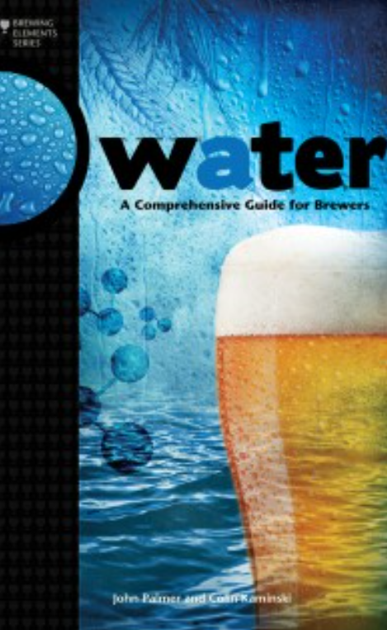
The night before (WATER PREP)
Water. Your first opportunity to geek out.
Get a water report, you have to call for this
Water profile can dictate what beers you can make well.
BOOK: Water: A Comprehensive Guide for Brewers
Pour the water the night before
Bypass your water softener! (unless you want a salty beer)
Chlorine tastes bad. Leave water out over night to dissapate.
Did you forget? Camdem Tablets (potassium metabisulfite)
Notes:
Some water can’t make some beers. This is a hard truth you may have to deal with.

Slide 13
The Mash
You extract sugars out the grain during the mash.
Notes:
Some water can’t make some beers. This is a hard truth you may have to deal with.

Slide 14
The Boil
Notes:
Some water can’t make some beers. This is a hard truth you may have to deal with.

Slide 15
Basics
Water
Grain
Yeast
Fermentation

Slide 16
Prepare the water in advance.
Bypass your water softener.
Chlorine tastes bad. Leave it out over night to rid yourself of that trash.

Slide 17
Brewing Tips and Tricks
How does do I not screw this up?

Slide 18
Brewing Automation
IoT - Intoxication of Things?

Slide 20


Slide 21
agenda

Slide 22
Title
Line1
Bullet Level 1
Bullet Level 2
Bullet Level 3

Slide 23
Title
Code

Slide 24
Text Only with Border
Level 1
Level 2
Level 3

Slide 25
Text Only (Red)
Level 1
Level 2
Level 3

Slide 26
Title
Text 1
Level 1
Level 2
Level 3
Text 2
Level 1
Level 2
Level 3

Slide 27
Title
Section 1
Section 2
Text
Level 1
Level 2
Level 3
Text
Level 1
Level 2
Level 3

Slide 28
Demo Title

Slide 29





























Slide 30






























Slide 31




























Slide 32




























Slide 33




























Slide 34




























Slide 35




























Slide 36























Slide 37
















